Slide 1
Group name : Tempcad
Robotics Term Project
201632314 허승효
201634930 박상우
201634936 백정웅
201635840 이정명

Slide 2
01
Introduction
Project Title
02
System & Architecture
Hardware component
Structure
03
Code Analysis
Code analysis
04
Final
Demo
Participation

Slide 3
Introduction

Slide 4
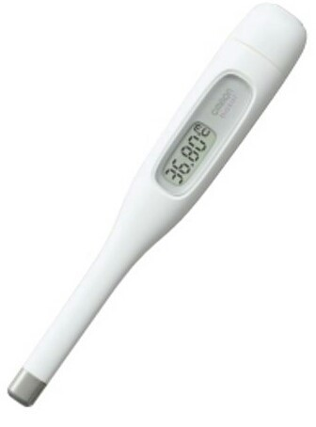

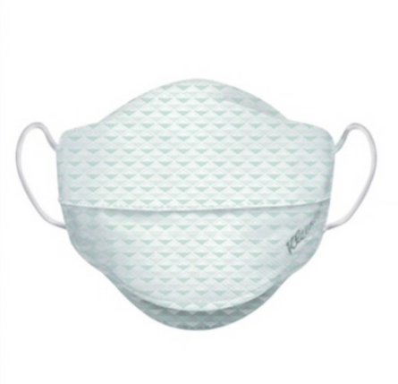

01. Project Title

Slide 5
System
& Architecture

Slide 6
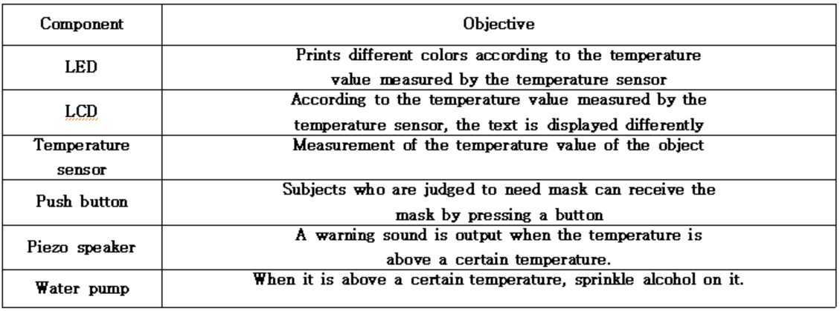
02. Hardware component

Slide 7
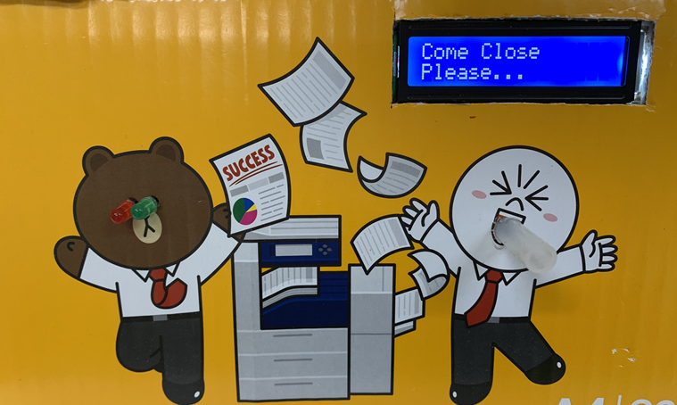
02. Structure
LCD
LED
Water Pump

Slide 8
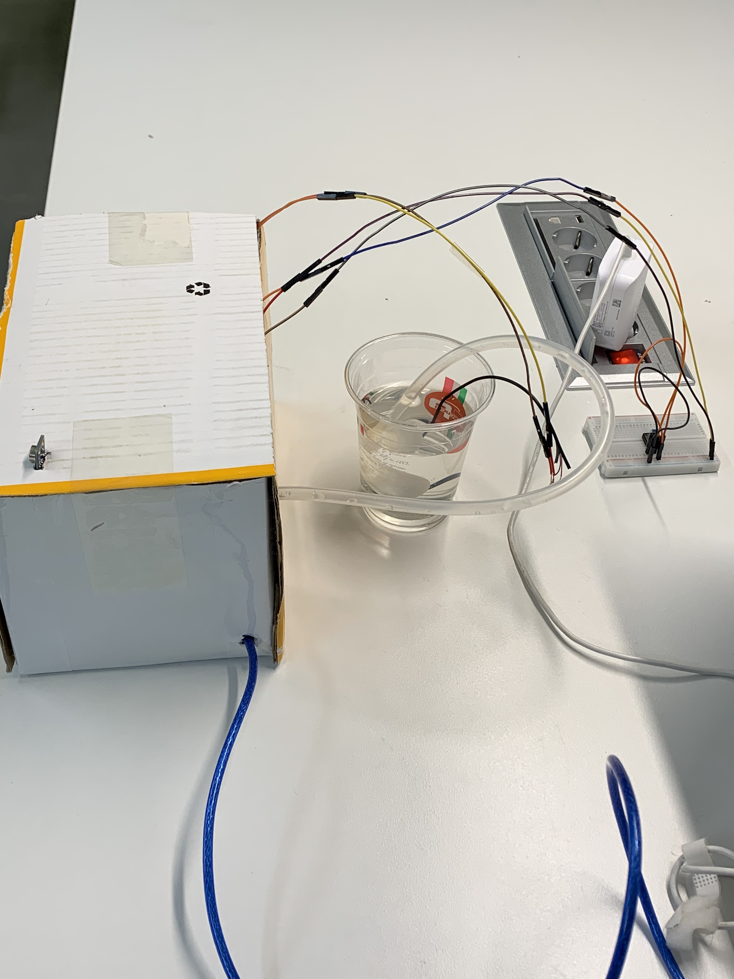
02. Structure
Temperature Sensor
Button
Alcohol

Slide 9
Code Analysis

Slide 10
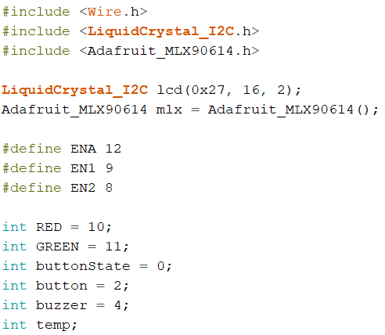
03. Code Analysis
Library
Variable

Slide 11
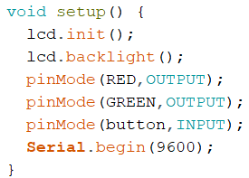
03. Code Analysis
LCD setting
LED setting
Button setting

Slide 12
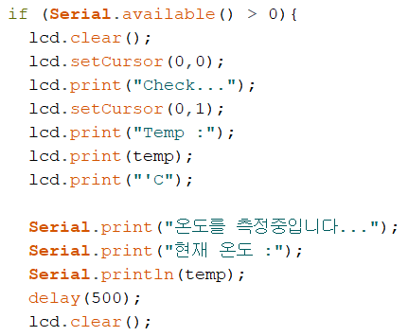
03. Code Analysis
LCD print
Serial print

Slide 13
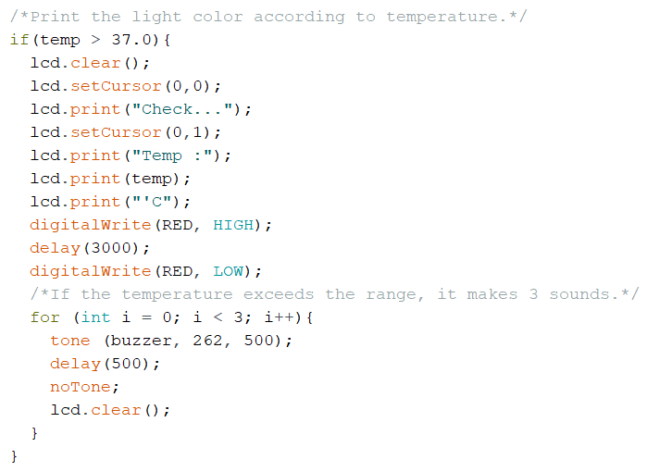
03. Code Analysis
If temperature > 37
LCD control
Red LED output
3 times beeps

Slide 14
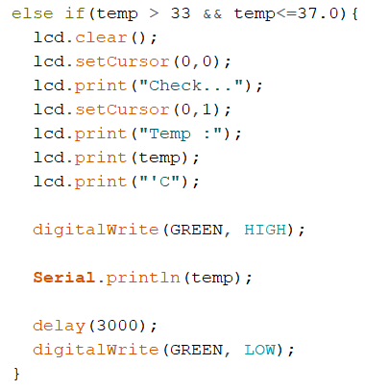
03. Code Analysis
If temperature in normal
LCD control
Green LED output

Slide 15
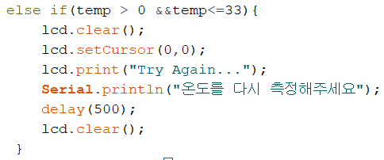
03. Code Analysis
If temperature <= 33
LCD control
Serial print

Slide 16
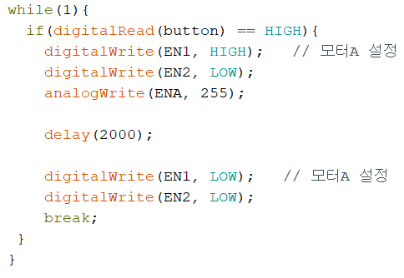
03. Code Analysis
Read push button
Water pump On
Water pump Off

Slide 17
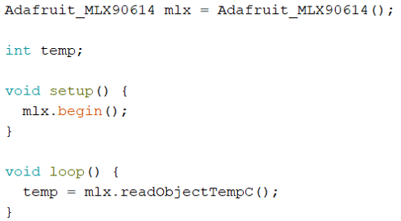
03. Code Analysis
Variable
Temperature
Sensor Setting
Return
Temperature

Slide 18
Final

Slide 19
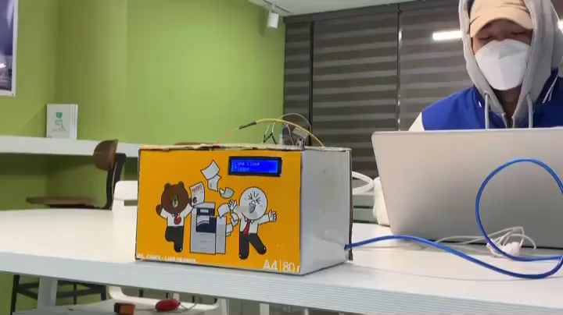
04. Demo

Slide 20
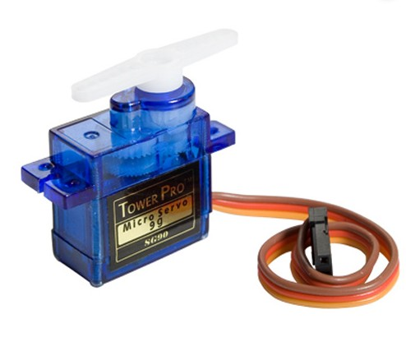


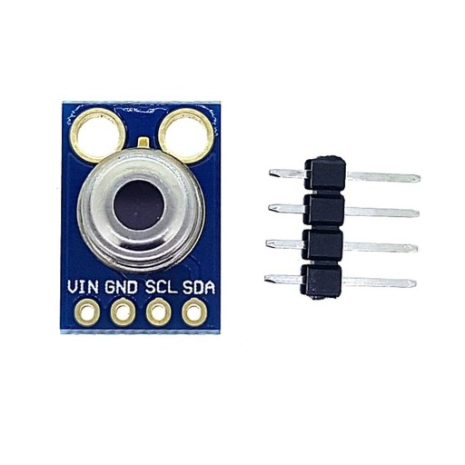
04. Conclusion

Slide 21

04. Participant
허승효
박상우
백정웅
이정명
Coding
Circuit wiring
25%
Coding
Circuit wiring
25%
Coding
Presentation
25%
Coding
Making PPT
25%

Slide 22
Thank you

